Slide 1
Polaris LEAP Offline Circulation
Training

Slide 2
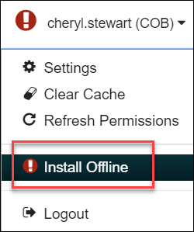
InstallING leap offline
You must have the Leap Offline permission enabled and use a compatible web browser to install the application (Not compatible with IE)
If Leap Offline has not been previously installed, you will see an installation Warning icon. To install, select the Warning icon.
Click on Install Offline. A temporary message will display “Installing Offline files.

Slide 3
InstallING leap offline
Once files are installed a confirmation message on a green background will display.
Click on the Leap Offline link.
It is very important to bookmark this page, for easy accessibility in the future when offline is needed.

Slide 4
Accessing leap offline
To open LEAP Offline go to the bookmarked URL
You can directly type the URL, but it is case sensitive
Example: https://--servername--/leapoffline/#/checkout

Slide 5
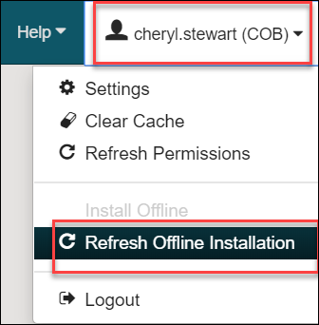
Refreshing leap offline Installation
Leap Offline will open in the browser
Click the Refresh Offline Installation
Refreshing the installation updates:
User ID
User Name
Workstation ID
Workstation Branch ID
Workstation Name
Branch ID
Standard Loan Period
Branch Name
Branch Phone
Branch Home Page
Branch Receipt Note
Locale Name

Slide 6
leap offline Settings – Print Options
This setting is to choose whether or not to print a receipt

Slide 7
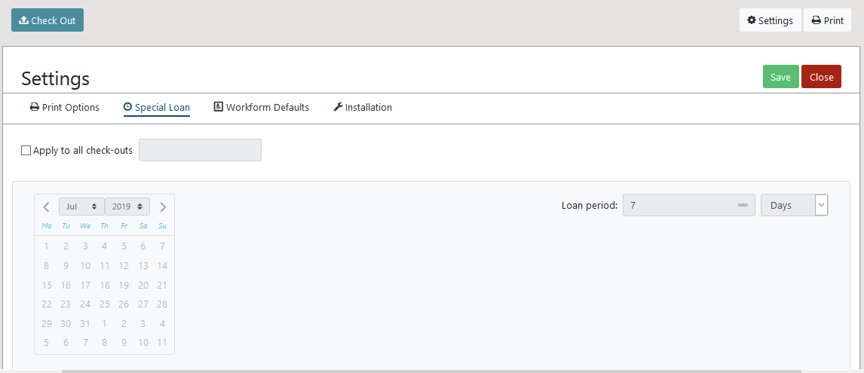
leap offline Settings – SPECIAL LOAN
This setting allows a specific loan period to be set and can apply it to all checkouts overriding the default (set in SA Polaris client)

Slide 8
leap offline Settings – WORKSFORM DEFAULTS
This setting shows the standard loan period that will be applied to all the checkouts (if special loan is not used.)

Slide 9
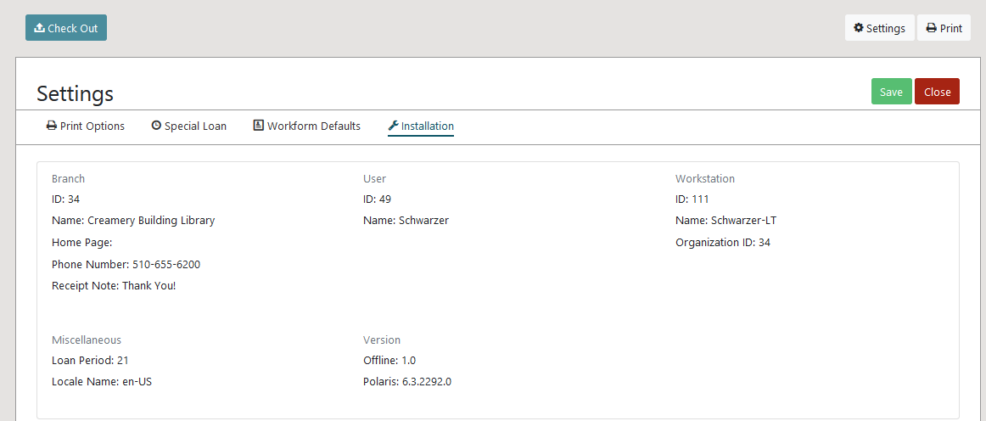
leap offline Settings – INSTALLATION
This setting displays Leap Offline installation values

Slide 10
LEAP Offline Circulation—check out
Scan the patron’s barcode
Note: No additional patron data will be stored locally
As item barcodes are scanned in, only the barcode can be seen and the due date is calculated per a default set in SA
After scanning all items, hit the complete button to finished the checkout and print receipt.
This will clear everything so you can start with the next patron

Slide 11
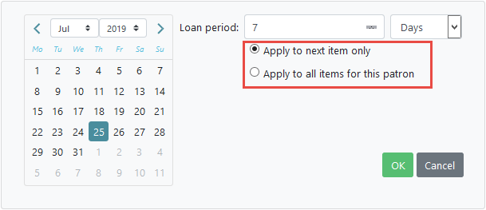
LEAP Offline Circulation—check out
If a different due date is needed, you can use the Special Loan button to set a different date prior to scanning the item.

Slide 12
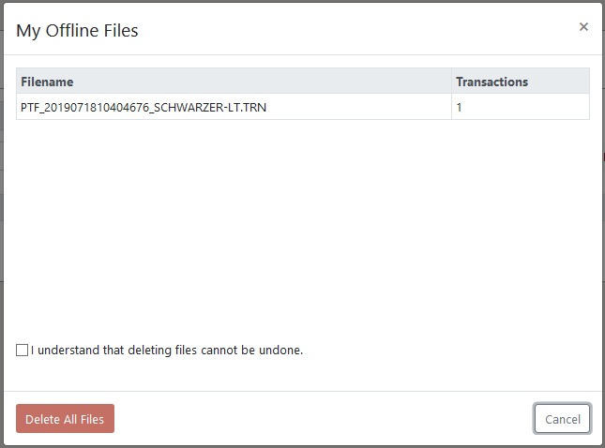
Offline circulation—check out
Offline transactions are stored in the local storage of the user's browser until the user chooses to send them to the server for processing or to delete them.
As you work in Leap offline, you will see your transaction count increment with each check out. The Transactions badge will keep you informed of your progress.
Selecting the Transactions badge opens a dialog showing all the offline transaction files you have generated, with an option to delete them. Deleting files cannot be undone.
Staff will not see patron or item blocks, or any patron data

Slide 13
UPLOADING OFFLINE TRANSACTIONS
When connection to your server has been restored,
Login to LEAP
If you have unprocessed offline transactions when you log into Leap, you will see the following message:

Slide 14
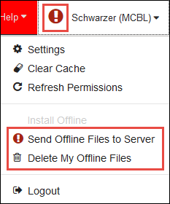
TRANSACTION FILES
The user profile is set to the Warning icon. Select the icon to access options to process the offline transactions.
The Send Offline Files to Server option sends all unprocessed offline transactions to the server for processing. All transactions sent to the server will be processed and uploaded using the Automatic Offline Upload process.
The Delete My Offline Files options deletes all unprocessed offline transactions from the browser. The deleted transactions cannot be recovered.
After selecting Send Offline Files to Server, LEAP displays a status pop-up.

