Slide 1
Series Authorities Information
Deborah Tomaras
Minerva Cataloging Roundtable
September 13, 2018
Notes:
Fix: Deaver, Jeffery.|tLincoln Rhyme novel?

Slide 2
Let’s start with the 490
Trace exactly what you see on the material in hand (book, audiobook, etc.). That includes:
  Articles (A, The, An, etc.)
  Wording
  Format of the numbers in the |v

Slide 3

Examples
Scott Reintgen, Nyxia unleashed.
  Title page reads: The Nyxia triad book 2
  490 should look like:
Shelley Shepherd Gray, Hopeful.
  Title page reads: Return to Sugarcreek book one
  490 should look like:

Slide 4
Where do we find the series?
Ideally, the series title page (facing the title page, or a bit before it. Usually includes the series name/s and books in the series)
  Prefer the version on the series title page to the version on the title page, if both exist
But, if there isn’t a series title page, you can use the title page, cover, book jacket, etc. as the basis for the 490

Slide 5
Example
Kristen Proby, All the way.
  Series title page says: The Romancing Manhattan series
  Title page says: A Romancing Manhattan novel
  490 should look like this:

Slide 6
Additions to the 490
Important series information that isn’t in the material itself is considered to be “externally supplied” and has to be enclosed in brackets [ ]
  Usually that’ll be numbering you want to include because the publisher didn’t put in on the book
  But occasionally it can be the series itself

Slide 7
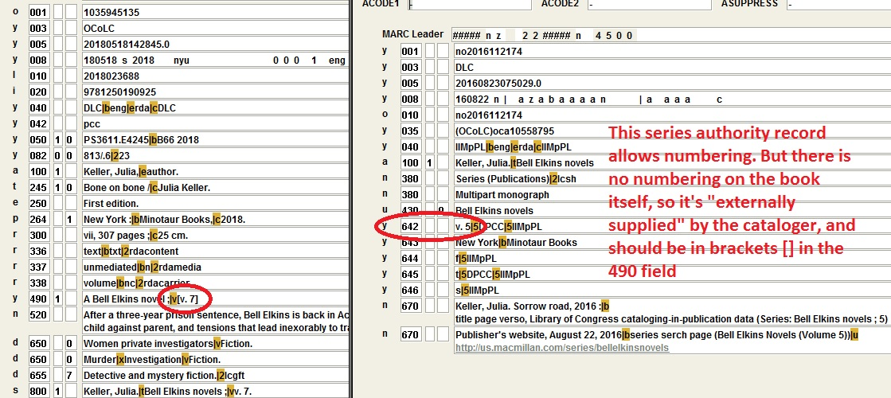
Example

Slide 8
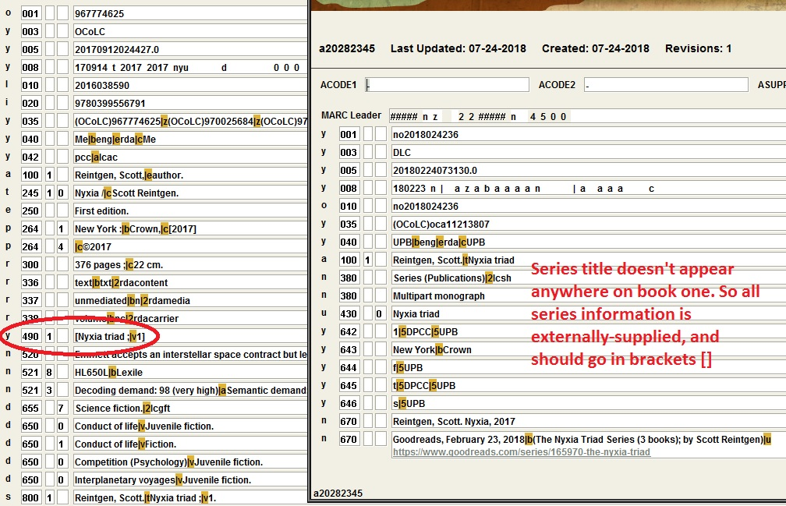
Example

Slide 9
An exception to the additions rule
If you’re supplying information about the corporate body/issuing body for the series (for example, if the series title is really generic), it’s formatted like this instead of in brackets:
  490 1_ Series title / Issuing body

Slide 10
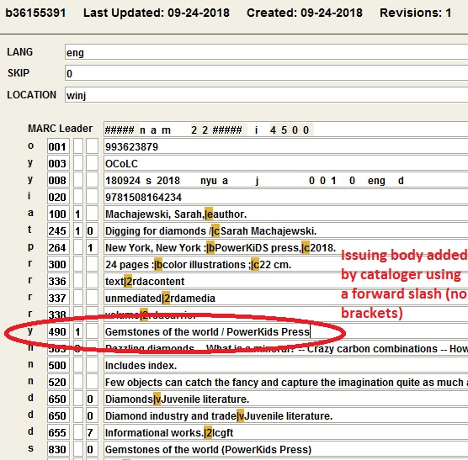
Example

Slide 11
Where NOT to put series information
If you’ve determined that something is a series, please do NOT also put its words in the 245, even if they’re duplicated on the title page and series title page.

Slide 12
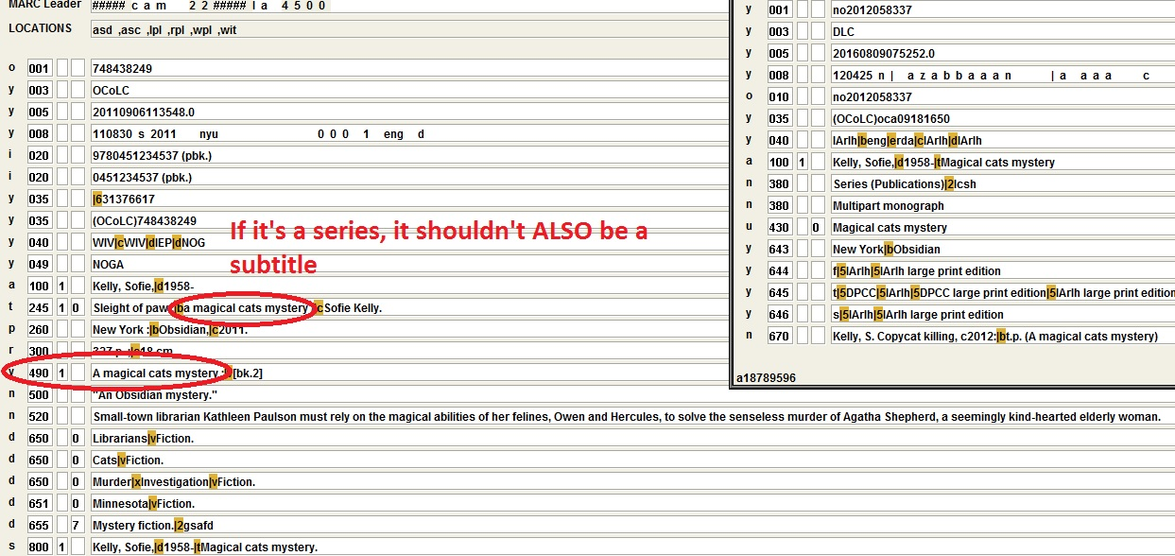
Example

Slide 13
How about those indicators?
If you have an 8xx in your record, the 490 first indicator should be “1”
If you DON’T have an 8xx in your record, the 490 first indicator should be “0”
***Beware of Library of Congress bibliographic records. They don’t trace series anymore, so ALL their 490s are 0s, whether they should be or not (and they lack 8xx, even when series authority records exist)***

Slide 14
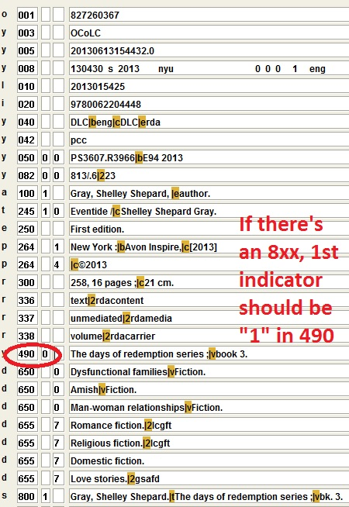
Example

Slide 15
How to verify 1 versus 0 for indicators
Look at the 645 field in the series authority record
  If it starts with a “t”, you should have an 8xx, and the first indicator in the 490 field should be “1”
  If the 645 field starts with an “n”, you should NOT have an 8xx field, and that first indicator in the 490 field should be a “0”

Slide 16
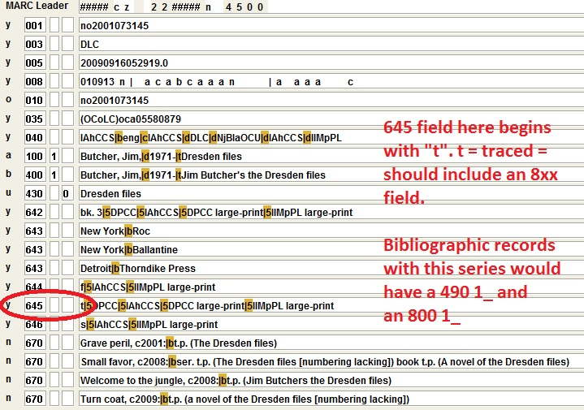
Example

Slide 17
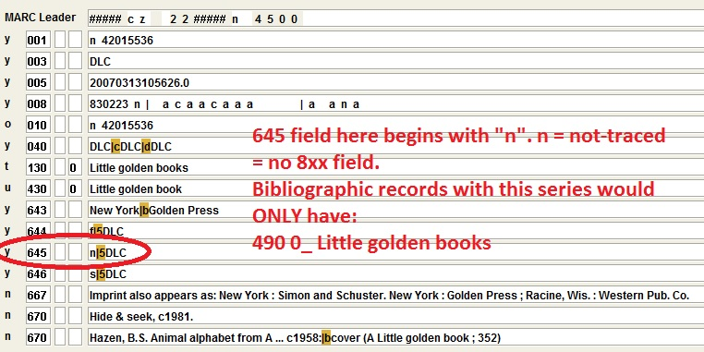
Example

Slide 18
On to the 8xx
So we’ve determined that the 490 should match exactly what’s in the material you’re cataloging.
What about the 8xx? That should match what’s in the series authority record. It doesn’t need to match the 490, unless the series is identical in the material and the authority record.

Slide 19
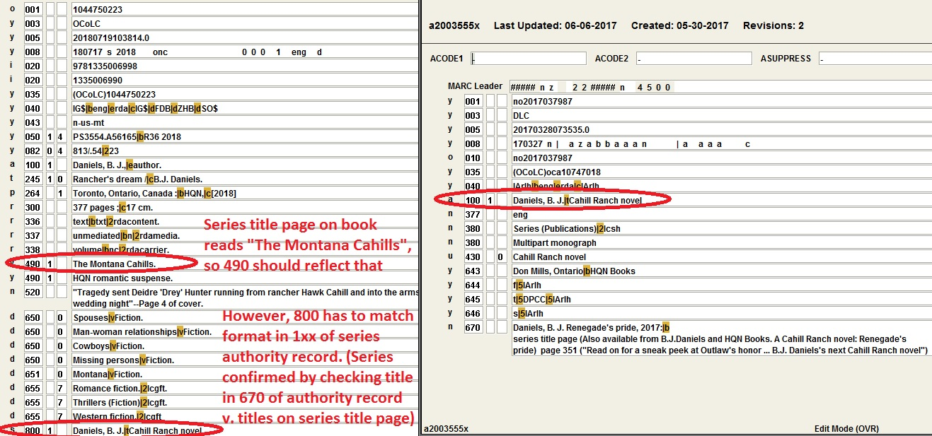
Example

Slide 20
800 versus 830
Check the 1xx field in the series authority record.
  If it says 100, then you have a name/title series, and it should be coded 800 1_ in the bib record
  If it says 130, then you have a title-only series, and it should be coded 830 _0 in the bib record

Slide 21
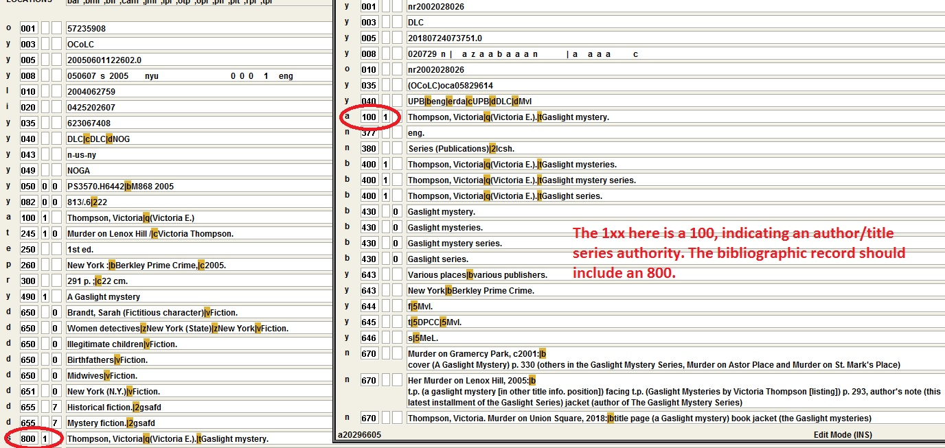
Example

Slide 22
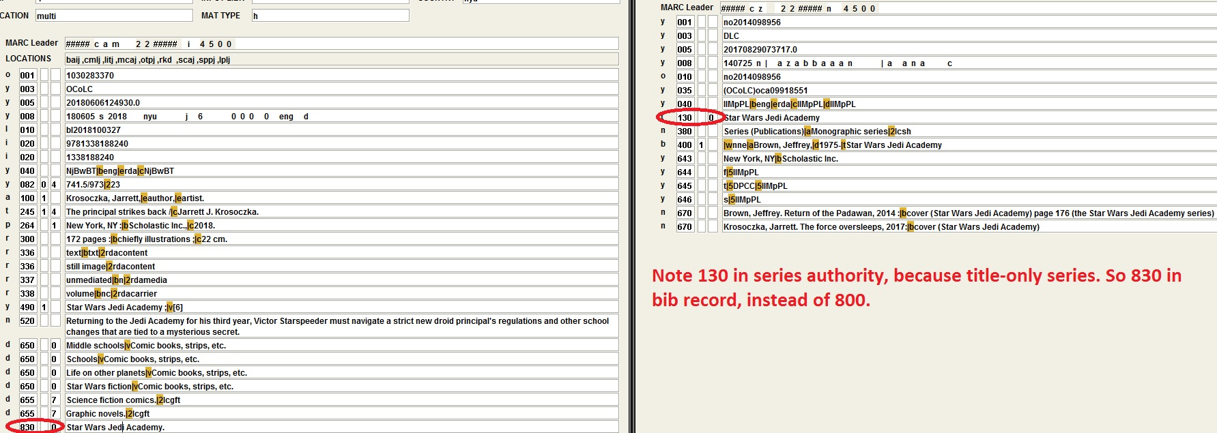
Example

Slide 23
Numbering in the 8xx
Remember that the 8xx must exactly match the series authority record?
  That means you can ONLY include numbers in the 8xx if they are ALSO in the series authority record.
  Check field 642. If there isn’t one, DO NOT put numbers in the 8xx.
  If there is a 642, the numbers in the 8xx must match the format in the 642 field (i.e.: v., bk., just numbers, etc.)
  ***Note also that there are no brackets [] allowed in the 8xx. So no numbering like this (example: [7])***

Slide 24
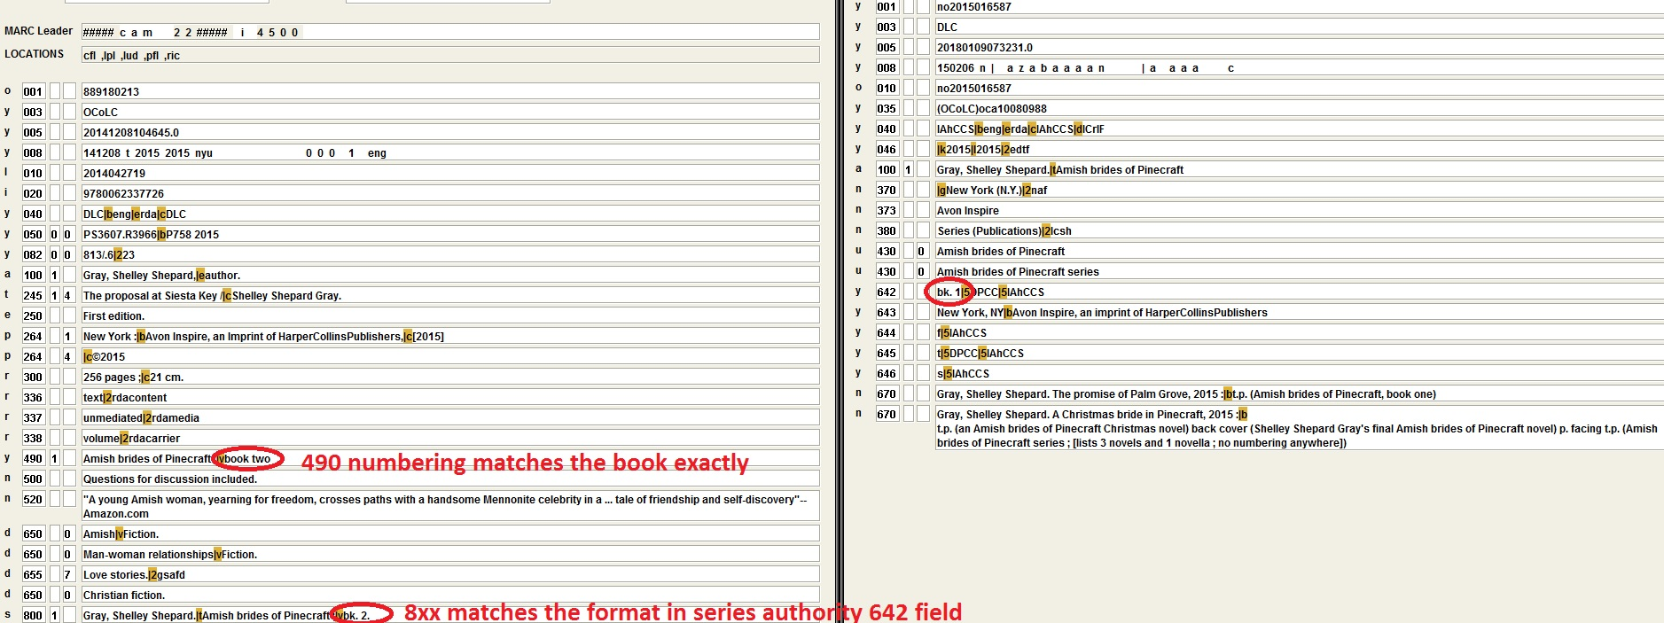
Example

Slide 25
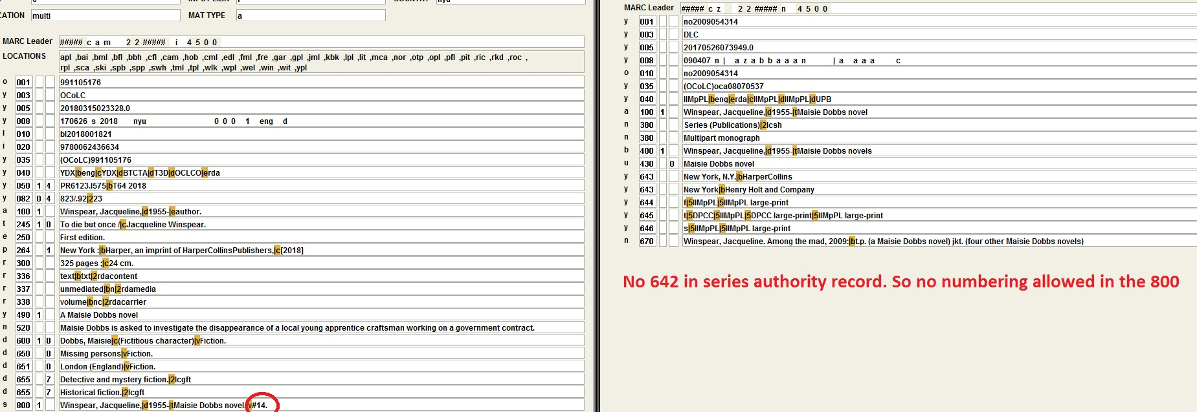
Example

Slide 26
Audiobooks versus Print
A special reminder to check for audiobook series authority records, as they are often treated slightly differently from regular print series authority records (sometimes not numbered or differently numbered, etc.)
  You can recognize them by words like “Audio” or “Spoken word” in the 1xx field
  Don’t just use the print series authority record without checking in Sierra and InnView and SkyRiver to see if there is an audiobook series authority record out there

Slide 27
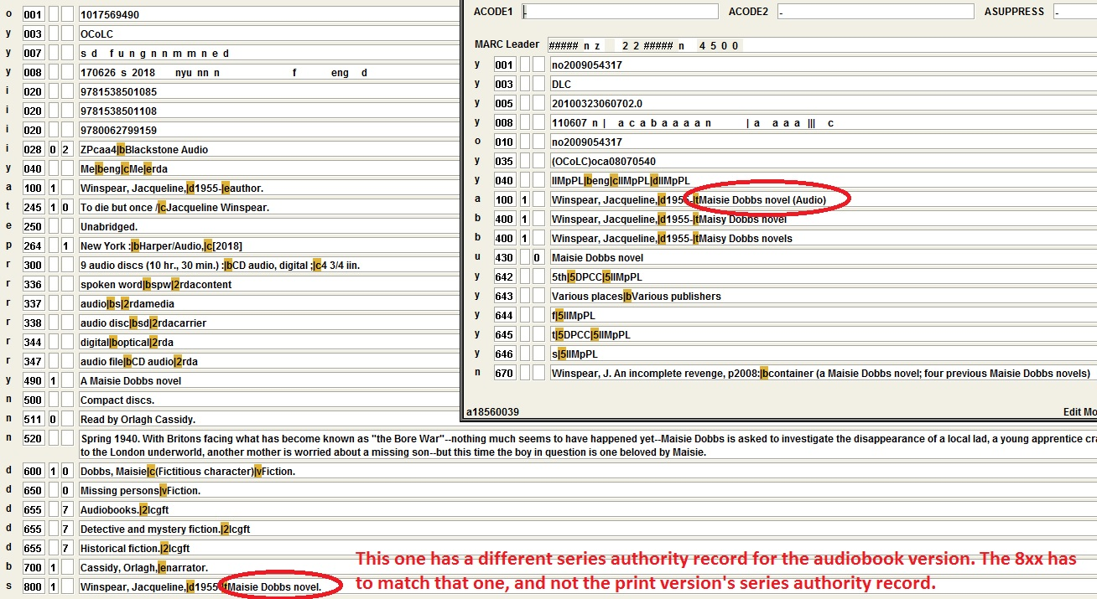
Example

Slide 28
Reminder of important fields in series authorities
So remember that you should look at the:
  1xx (to determine form of 8xx field)
  642 (to determine if numbering is allowed, and if so how to format it)
  645 (to determine whether to trace the series or not, i.e. if an 8xx is allowed)
Sometimes, though, there are other fields to pay attention to in a series authority record, like the 667 (which explains series numbering oddities, differences between large print and regular print series tracing, etc.)

Slide 29
Series records that aren’t
That 667 is particularly important when there are authority records for series that indicate that they shouldn’t be considered series.
In these, there is no 645 tracing field, and the 667 usually explains where to put the series-like words instead of in a 490/8xx (or not to put them anywhere)

Slide 30
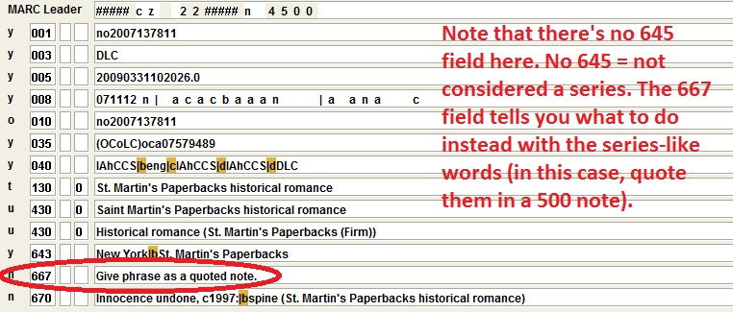
Example

Slide 31
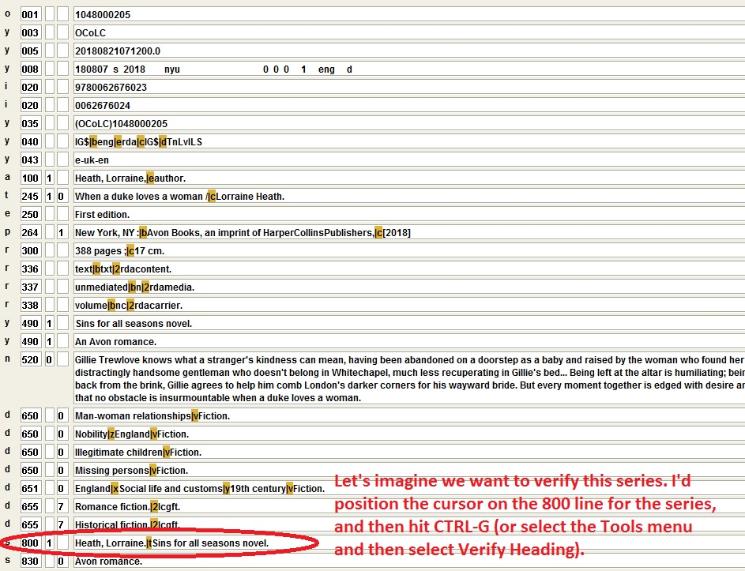
Example of how to search for series authority records

Slide 32
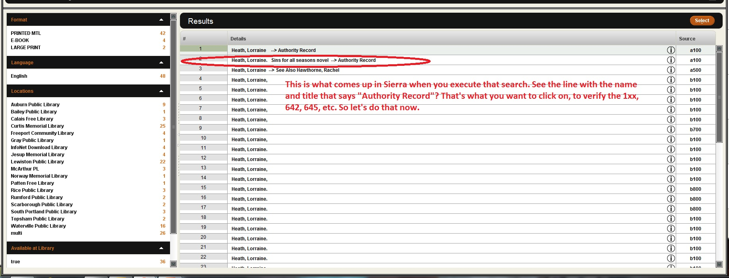

Slide 33
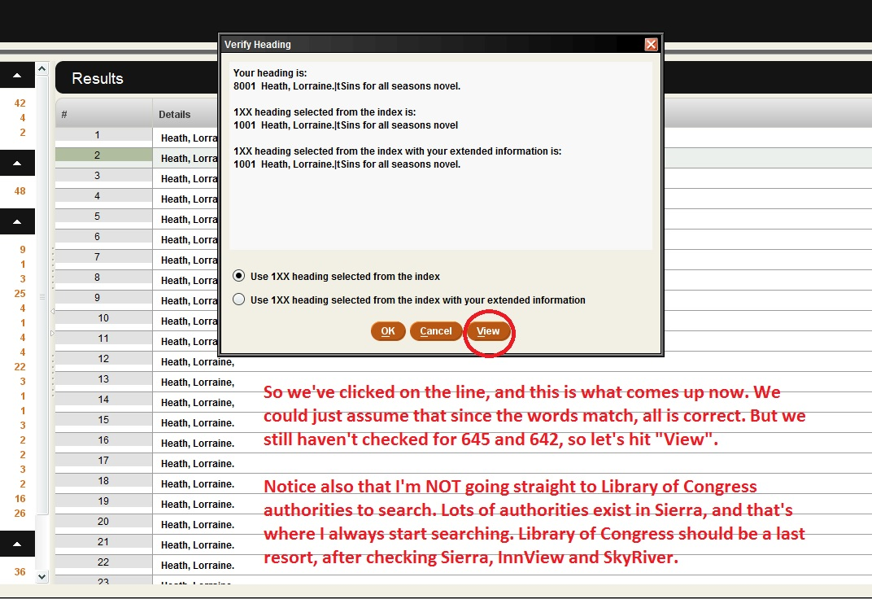

Slide 34
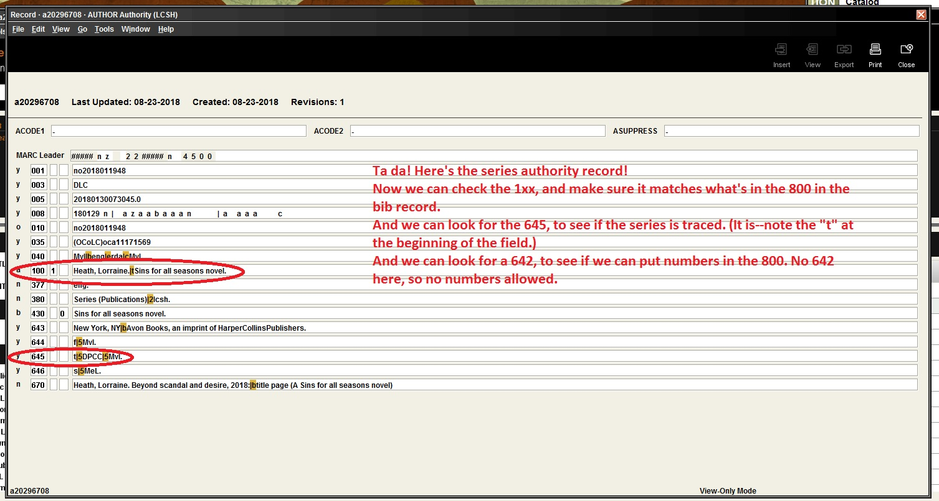

Slide 35
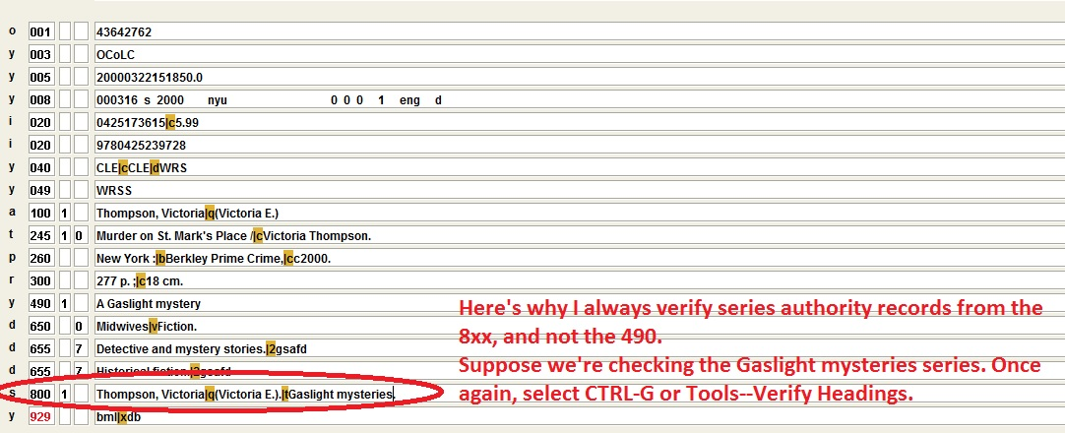
Always search your series authorities from the 8xx field…

Slide 36
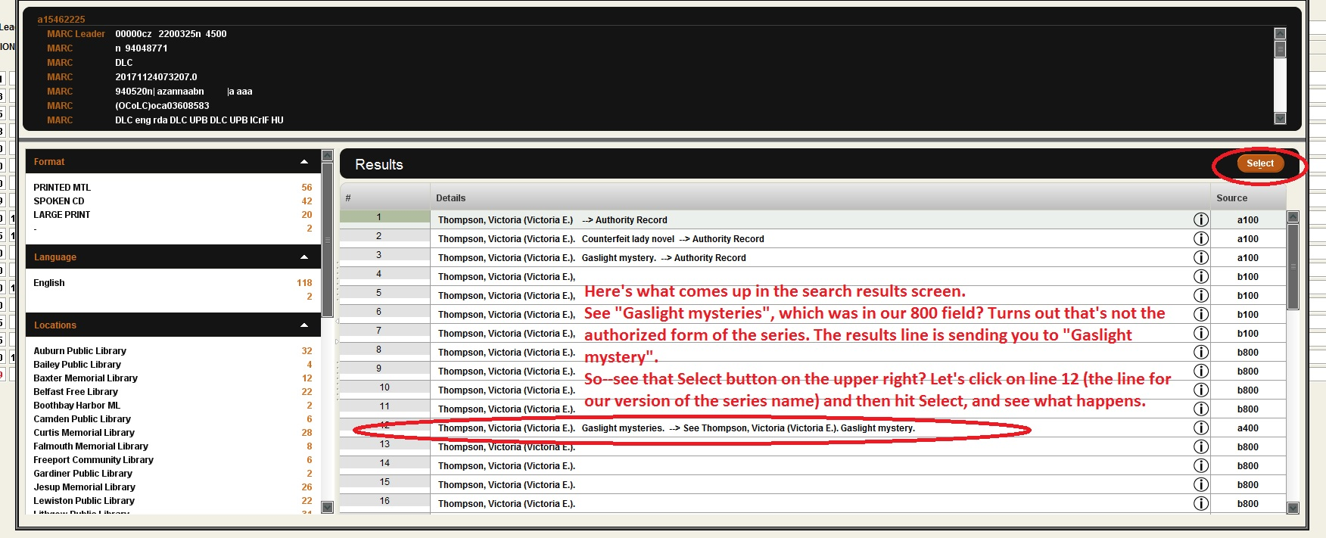

Slide 37
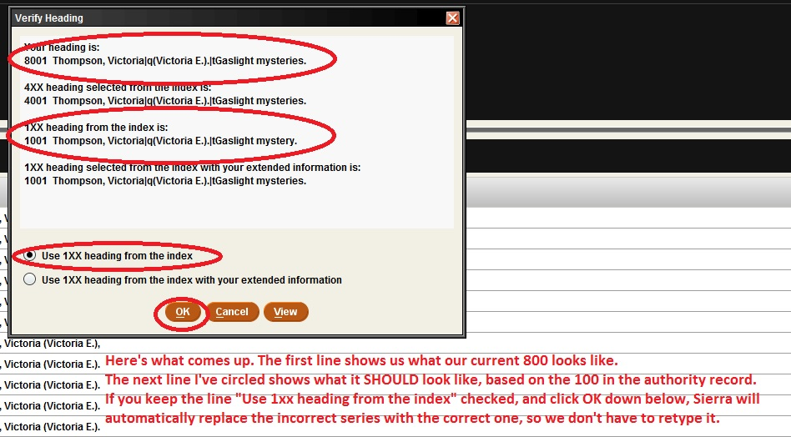

Slide 38
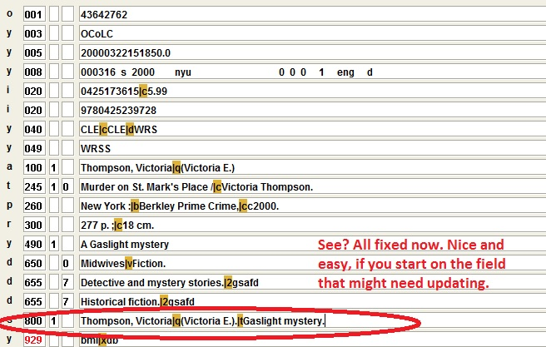

Slide 39
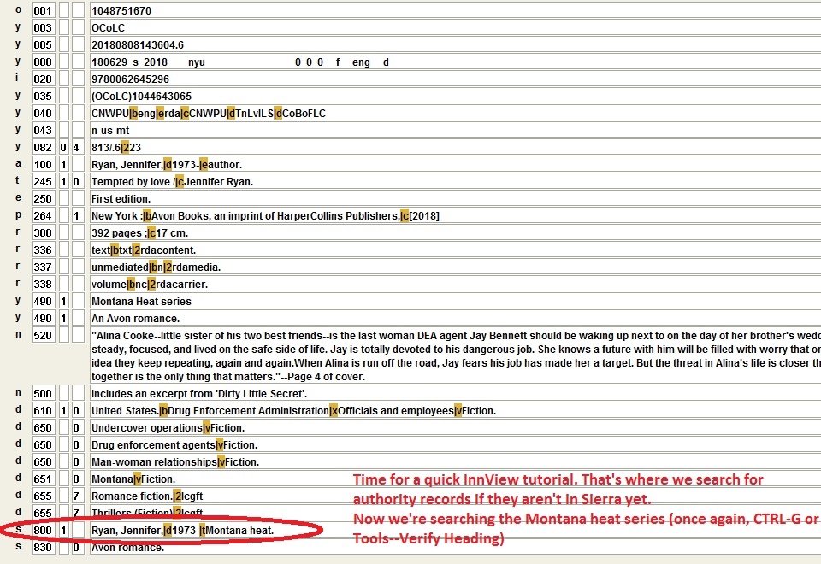
How to Search InnView for series authority records

Slide 40
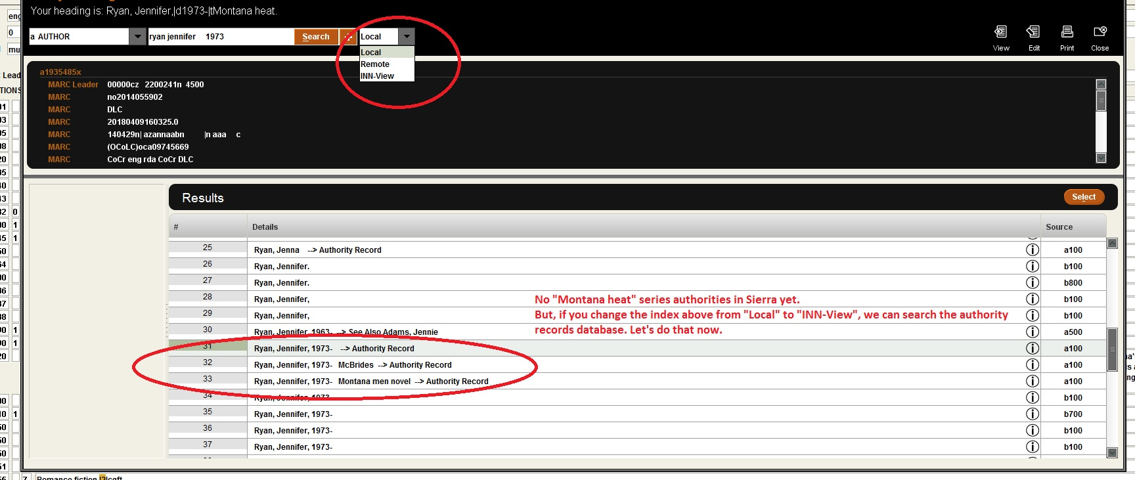

Slide 41
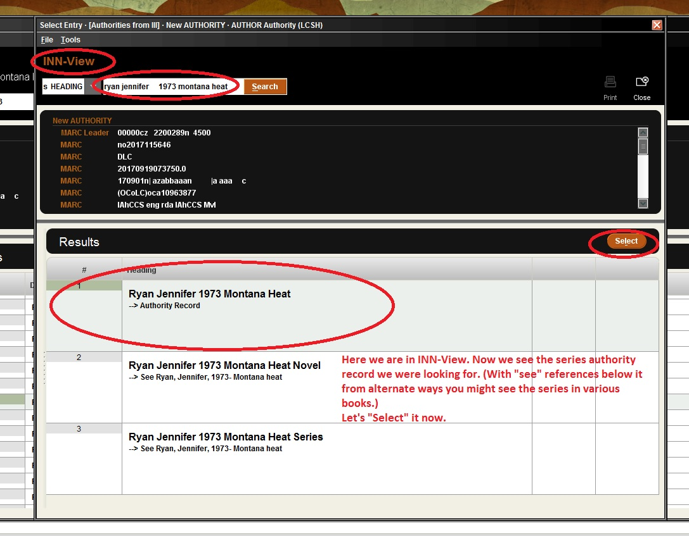

Slide 42
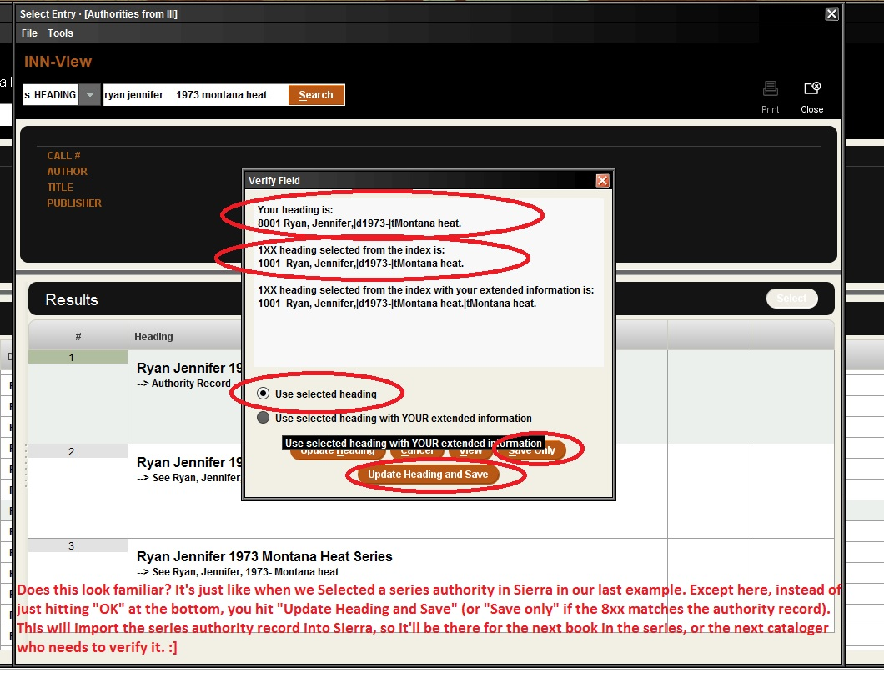

Slide 43
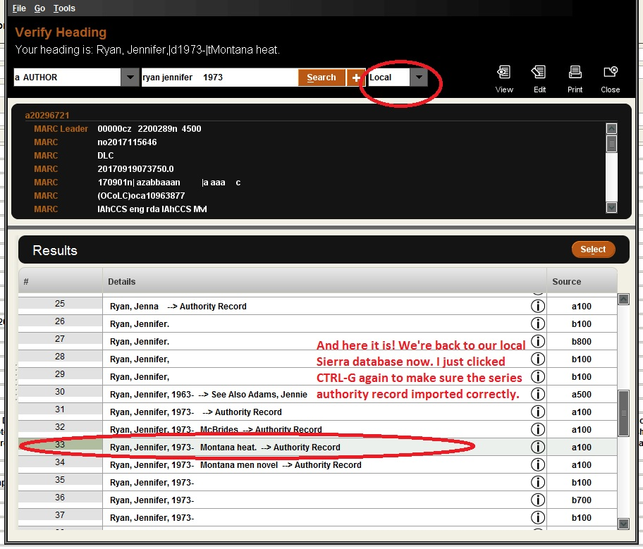

Slide 44
The End (Finally…) ;]
If you are cataloging something with a new series that doesn’t exist yet (i.e., you’ve checked Sierra, InnView, SkyRiver and authorities.loc.gov, and it’s not in any of them), feel free to email me, and I can establish the series in the authority file so that it will exist.
And please retroactively tidy up series whenever you are adding new volumes and spot errors, so they’ll be easier for patrons to navigate in the catalog.
And please send me anything you find that looks like it should be a series, but its record says it isn’t (no 645, and a 667 note explaining to trace it elsewhere or not at all). I’ll try to “upgrade” those to series records, when appropriate.
And thanks for listening!

