Slide 1
How to Spot a Bootleg DVD Minerva Cataloging Roundtable 12 September, 2018

Slide 2
It is easy to spot bootlegs in toys, animation, and movie posters.

Slide 3
It isn’t easy to spot a fake DVD or is it ……?

Slide 4
Before adding the DVD
Double check to make sure the DVD has officially been released. Especially those that are from a streaming service like Netflix or HULU.
Amazon is not the place to check since they have sold bootleg DVDs.
The best thing is to research the release dates.

Slide 5
A few things to check
Look for copyright movie companies copyright their DVDs.
If the disc says it will play in all regions do not add. (more about this later)
An advertisement of DVD-9 is often associated with pirated DVD’s.
A double ring around the disc is another way to identify a bad DVD.

Slide 6
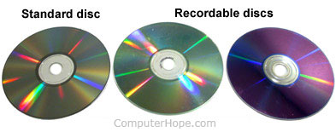
Checking the Disc Color
If you turn the discs towards the light legitimate DVDs are silver. If the disc are green, purple, or another tint to them then it is an illegal DVD.
Comparison of real CD and recordable CD discs
https://www.computerhope.com/issues/ch001252.htm

Slide 7
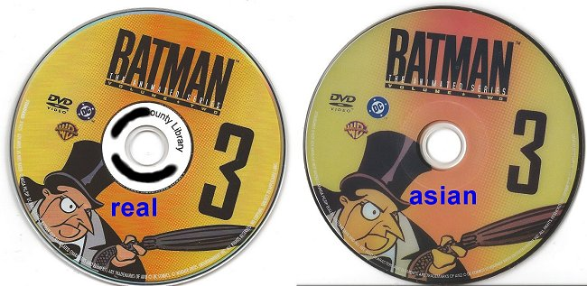
Labels
If the label looks pixelated, hand written, or printed off an ink printer then it could be a bootleg.
https://www.computerhope.com/issues/ch001252.htm

Slide 8
Regions
Global region codes identify DVDs and Blu-ray discs that are compatible with the players typically sold in that region.
The following are the different regions and their corresponding numerical equivalent:
Standard DVDs
Region 1: U.S., U.S. Territories, Canada, and Bermuda
Region 2: Japan, Europe, South Africa, and the Middle East, including Egypt
Region 3: Southeast Asia, East Asia, including Hong Kong
Region 4: Australia, New Zealand, Pacific Islands, Central America, South America, and the Caribbean
Region 5: Eastern Europe, Baltic States, Russia, Central and South Asia, Indian subcontinent, Africa, North Korea, and Mongolia
Region 6: China
Blu-ray Discs
Region A/1: North America, Central America, South America, Japan, North Korea, South Korea, Taiwan, Hong Kong and Southeast Asia
Region B/2: Europe, Greenland, French territories, Middle East, Africa, Australia and New Zealand
Region C/3: India, Nepal, Mainland China, Russia, Central and South Asia
Note: Most of the DVDs and Blu-ray discs sold by Amazon.com are only encoded for Region 1 or Region A. These titles only play in one region unless noted otherwise.
https://www.amazon.com/gp/help/customer/display.html?nodeId=200492990

Slide 9
Websites for more information
http://www.swapadvd.com/help/help_item.php?id=624
Includes tips on how to spot professional looking copies
https://www.computerhope.com/issues/ch001252.htm
Includes photos of DVD/CD and links to more help
https://www.wikihow.com/Spot-Fake-DVDs
Also with photos of covers
http://tinyurl.com/y777rnxc
eBay community answers for spotting bootleg DVDs
Thank you to Nancy Grant for the website information

