Slide 1
Useful information about Genres
Minerva Roundtable Meeting
April 5, 2018

Slide 2
What on earth do genre terms describe?
FORM of an item
Audiobooks
Large print
Board books, etc.
GENRE/TYPE of an item (broad bookstore category organization as opposed to subject)
Detective and mystery fiction
Science fiction comics
Animated television programs, etc.

Slide 3
A genre heading ISN’T a subject heading
Subjects (650s, 600s, 610s, 630s) describe what a material is ABOUT (topic/subject)
So a book might have subject (650) fields “Cowboys—Fiction” and “Man-woman relationships—Fiction” (since that describes the plot/characters/etc.).
Genres (655s) describe what a material IS (form/genre)
So that book from above might have the genre (655) heading “Romance fiction” (since that’s the category of materials the book belongs to. It’s not ABOUT romance fiction [i.e., the plot is not discussing the craft of romance fiction] but it IS a book of romance fiction)

Slide 4
What are genres good for?
Match points in bib records for finding groups of materials (even useful if the patron is doing a keyword search)
For example, at Lewiston Public Library all new graphic novels get the genre heading “Graphic novels”, and users can search for these with newest sorted on top to see what we’ve just added
Access to cross-over books which straddle multiple genres but need to be shelved in one location
Paranormal mysteries; Paranormal romance; Paranormal cookbooks?
Another way to see how various parts of library collections are circulating
A way to grab all the cookbooks, all the alphabet books, etc.
Some ILS systems even index them separately from subjects, so they can be searched by themselves (coding now for future ILSes?)

Slide 5
What kind of records can we put them on? All sorts!
Usually in fiction and audio-visual materials but really useful in juvenile and YA books too.
Some great genres for kids’ books help patrons search the collection in a more granular manner (like “Picture books” or “Alphabet books” or “Stories without words” or “Toy and moveable books” or “Picture puzzles”)
They’re also nice for nonfiction!
Biographies, guidebooks, atlases, cookbooks, course materials, etc.

Slide 6
What genre vocabularies are there to use? (In descending order of preference)
LCGFT: Preferred because current and continuously updated (now a 90 page PDF!). Choose these genre terms first. Full list at: https://www.loc.gov/aba/publications/FreeLCGFT/GENRE.pdf
BORROWING FROM LCSH: Useful if you need a term not yet incorporated into LCGFT (i.e., “Large type books”, “Board books”, “Children’s stories”, etc.).
GSAFD: Older vocabulary, developed before LCGFT. Great for their time, but no longer updated/expanded. Replace these or at least augment these with LCGFT versions of terms. Small scrollable list at: http://experimental.worldcat.org/gsafd/browseGSAFD.html

Slide 7
What they should look like?
Since these are NOT subjects, they should all start with 655 (which means genre)
LCGFT/GSAFD: 655 _7 [Term] |2 [Vocabulary]
The second indicator “7” means a vocabulary will be specified
in the |2, so you always need to use those two bits together
Headings borrowed from LCSH: 655 _0 [Term] (that second indicator “0” means taken from LCSH)

Slide 8
A note about 655 _7 versus 655 _0
Question: I have seen both 655 _0 and 655_7[Genre].|2lcgft for the same term (i.e., Animated television programs). The authority heading in LOC shows 155__|a Animated television programs, so it seems that just the 655_0 would suffice?
Two-Part Answer: There was a time when LCGFT didn’t exist, and a time when the vocabulary was under development, so not all the terms that exist today used to exist. So it’s possible that older records have more 655 _0 headings. But now that LCGFT is developed, it’s best to use 655 _7 [Genre] |2 lcgft whenever possible.
Also: The headings at authorities.loc.gov show the form the text string should take, but not all the numerical coding. You need to look at the 001 to see if the heading is an lcgft (gf prefix) which would need _7 coding, or if it’s a subject (sh prefix) that needs _0 coding

Slide 9
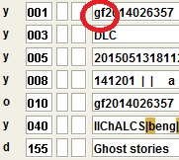
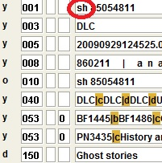
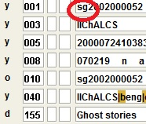
How can I tell which code to put in the second indicator and |2?
Look in 001 prefix code of the authority record: “gf” means LCGFT, “sg” means GSAFD, and “sh” means LCSH. Always prefer the LCGFT version if there is one.

Slide 10
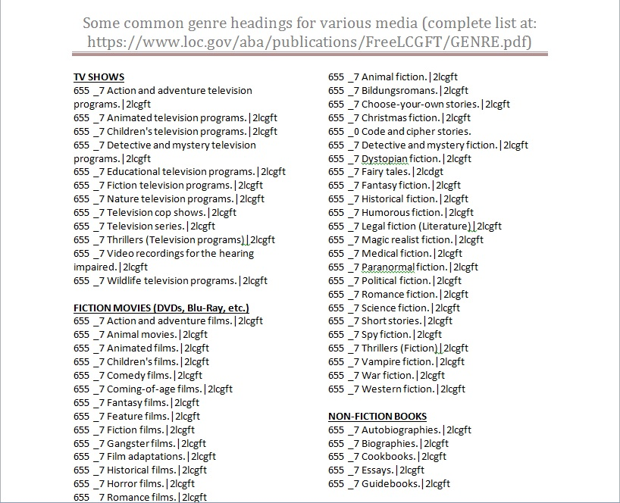

Slide 11
When switching from GSAFD to LCGFT
Some headings are exactly the same, and just need |2 code change from “gsafd” to “lcgft”
Fantasy fiction |2 gsafd versus Fantasy fiction |2 lcgft
Some headings are different, and either need two genre fields (one for gsafd and one for lcgft if you’re keeping the gsafd) or a whole field replacement of gsafd by lcgft
Suspense fiction |2 gsafd versus Thrillers (Fiction) |2 lcgft
Some gsafd headings combine multiple terms, and so need MORE THAN ONE lcgft field to make them equivalent
Romantic suspense fiction |2 gsafd versus Romance fiction |2 lcgft AND Thrillers (Fiction) |2 lcgft

Slide 12
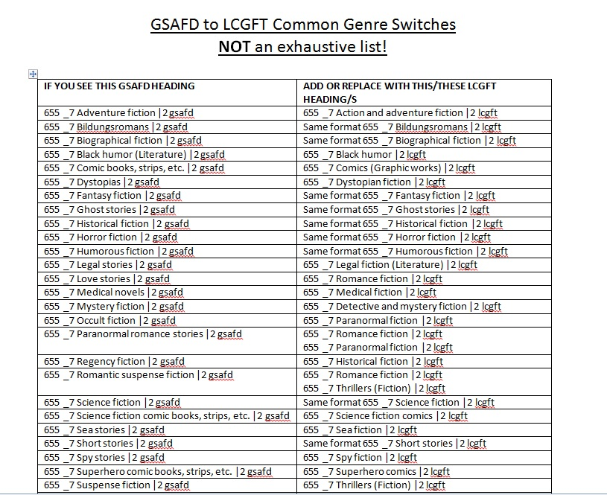

Slide 13
How can we bring them in via Z39.50?
Make this a d
This is how genre headings look in remote records. If you don’t change that “Z39.50” code to anything else, the headings will be deleted when you save the record locally. Please arrow over to that part of the field (or click on it and highlight it) and replace “Z39.50” with “d”, so the genres will stay in the bib record, and be indexed with subjects.

Slide 14
More Z39.50 Fun
Make this a
d
too
Sometimes, if you copy and past genre headings from remote records (either to another record in remote, or to an existing local bib record), the heading will have an “M” instead of a “d” in the indexing area. Please also change this “M” to a “d”, otherwise…

Slide 15
What happens if you don’t change that “M” to a “d” for your genre headings
…what happens is that instead of being displayed with the subjects, the genre headings appear in the OPAC with the label “Math Data”.

Slide 16
Practice Time!
Remember: all genres should be 655 _7 [Term] |2 or 655_0
Change all 650 genres to 655s
Delete or fix all genres with different second indicators (1, 4, etc.) or |2 with words like “local”
Remember also to code for the correct vocabulary!
lcgft
gsafd

Slide 17
How to spot and correct genres in records
Changed first two genres to lcgft and added |2 information. Changed 650 to 655 for third heading.

Slide 18
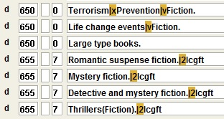
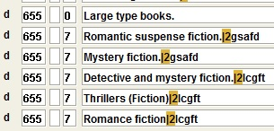
Changed first genre from 650 to 655. Fixed |2 information for second and third genres. Fixed spacing in text of fifth genre. Added sixth genre as part of LCGFT equivalent of second genre (Romantic suspense fiction)

Slide 19
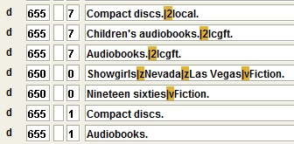
Eliminated erroneous first genre (not an acceptable vocabulary), also the last two (repetitive and incorrect coding with second indicator 1). Added plot-related genre from the print book bib record.
Note: print book bibs are a nice place to find genres for audiobook records! :]

Slide 20
Any questions?
The two cheat sheets (and this PowerPoint) will be sent around via the MinervaCats list on Friday
Please add to them when you find interesting genres, and share with the rest of us (with correct coding, please)!
And once more with feeling, that lcgft list: https://www.loc.gov/aba/publications/FreeLCGFT/GENRE.pdf

