Slide 1
Review of Proposed MSCC Retention Model
Matthew Revitt, Maine Shared Collection Librarian, University of Maine
August 12, 2019
www.maineinfonet.org/mscs/

Slide 2
Collection Analysis Work
28 ME libraries, mixture of academic and public, large & small
Analyzing approx. 422,000 print monographs, published or added between 2003-2012
May-July, 2019 MSCC Collections & Operations Committee used GreenGlass tool to analyze group collection
Retention factors considered:
Mixture of academics & publics
Overlap in group
Circulation history
Holdings levels in OCLC WorldCat
Availability in the HathiTrust
Commitments from regional shared print program EAST

Slide 3
Guiding Principles & Objectives
Protecting print monographs to ensure they remain accessible for library users in ME and beyond
Determine which titles should be retained long-term & how many copies
Equitably distribute retention responsibility across the group
Determine categories of material that don’t need retention commitments
Libraries may discard materials or not, once retention decisions are made, but downsizing is not the predominate focus
MSCC an example for other programs to follow

Slide 4
What Has Changed?
Large numbers of commitments from original analysis & in some cases retaining material would have otherwise withdrawn
More libraries participating in 2019 analysis -- share retention burden
71% only held by one library in group
Analyzing newer titles
MSCC no longer the only shared print program in the region
Staff turnover, fresh perspectives

Slide 5
Results of Original Analysis

Slide 6
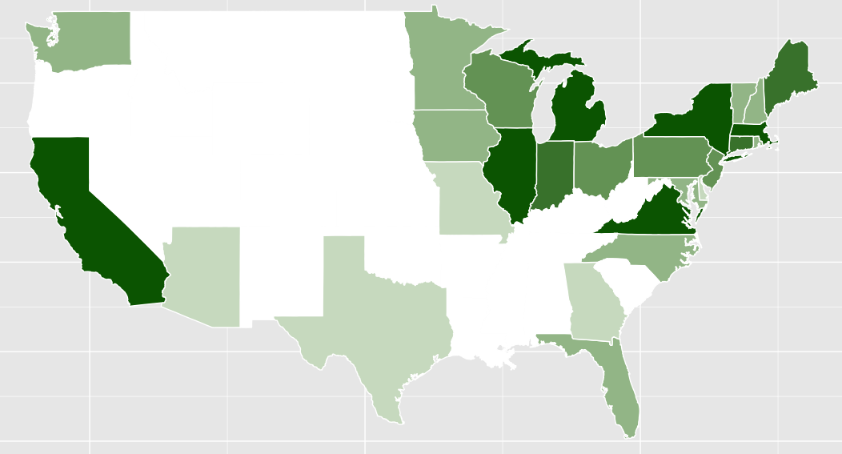
U.S. Shared Print Retentions by State
279K
126K
753K
141K
1.5M
3.3M
3.6M
253K
410K
4.3M
1.4M
482K
166K
2.2M
1.9M
924K
707K
113K
37K
2.8M
9K
3.2M
3.8M
236K
17K
17K
47K
100K

Slide 7
Proposed Academic Retention Model
Model applies to academic libraries & MSL only:
Rarity
Retain ALL copies of titles where fewer than 10 U.S. holding in OCLC WorldCat (Any edition)
Usage
Retain 2 copies of titles with 8 or more aggregate uses held by multiple libraries in group (Any edition)
Retain 1 copy of titles with 4 or more aggregate uses held by only 1 library (Any edition)
Not retaining
titles with 1-3 aggregate uses
titles held by multiple libraries & fewer than 8 aggregate uses
anything in our “ephemera” category
with existing MSCC commitments.

Slide 8
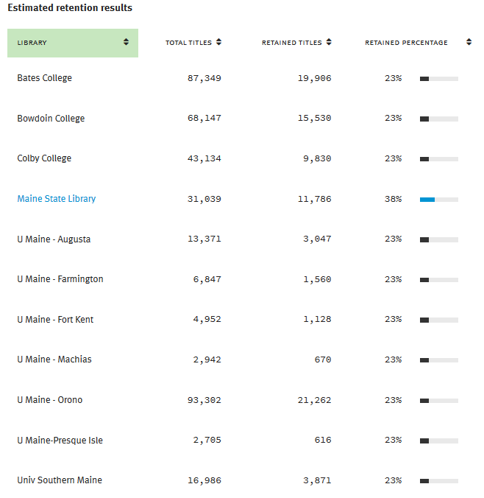

Slide 9
Arguments in Favor of Model
Still protecting content in the state, but less burdensome than original commitments
Uncomplicated and easy to explain & apply
Fairly equitable commitment levels across the group & inline with public libraries model
Rule 1 consistent with original 2013 model -- keeping all copies of rare material
Keeping material in Maine, so less reliant on ILL for access

Slide 10
Possible Changes
Retain more:
Committing to titles with 1-3 circs.
Keep only 1 copy of higher circ to balance keeping wider range of titles
Current model is a major difference to original model & may be seen as undermining philosophy & reputation of MSCC
Numbers game, developing model to fit desired percentages
Retain fewer:
Further limit to more recent transactions (last checkout)
Space issues & freedom to weed locally
Currently doesn’t take into account the copies of titles being retained by EAST libraries, duplicating commitments

Slide 11
Proposed Publics Retention Model
Model applies to Bangor, Portland pubic libraries and Minerva only:
Rarity
Retain ALL copies of titles where fewer than 10 U.S. holding in OCLC WorldCat (Any edition)
Usage
Retain 1 copy of titles with 10 or more aggregate uses held by 1 or more libraries, with a last charge date after 2014 (Any edition)
Not retaining
titles with 1-9 aggregate uses
titles with 10 or more uses pre-2014
anything in our “ephemera” category
with existing MSCC commitments.

Slide 12
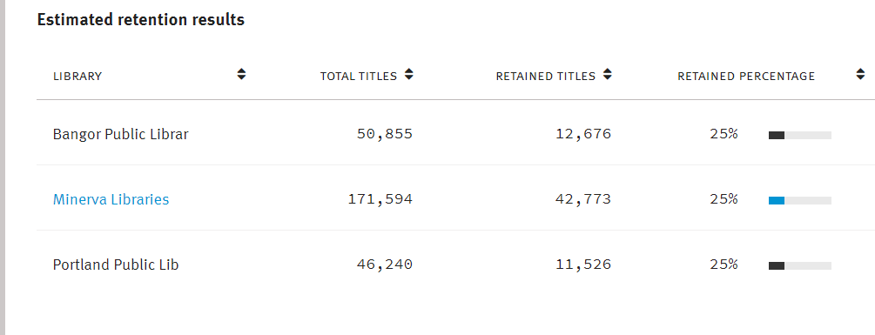

Slide 13
Arguments in Favor of Model
Still protecting content in the state, but less burdensome than original commitments
Uncomplicated and easy to explain & apply
Fairly equitable commitment levels across the group & inline with academic libraries model
Approved by Bangor Public & Minerva libraries

Slide 14
Arguments Against Model
Retaining less content is in general a risk
Numbers game, developing model to fit desired percentages
Retaining only 1 copy also a risk, but consensus easier to replace

