Slide 1
Introduction (or reintroduction) to Maine Shared Collections
Matthew Revitt, Maine Shared Collection Librarian, University of Maine
Larger Libraries Meeting
December 14, 2018
www.maineinfonet.org/mscs/

Slide 2
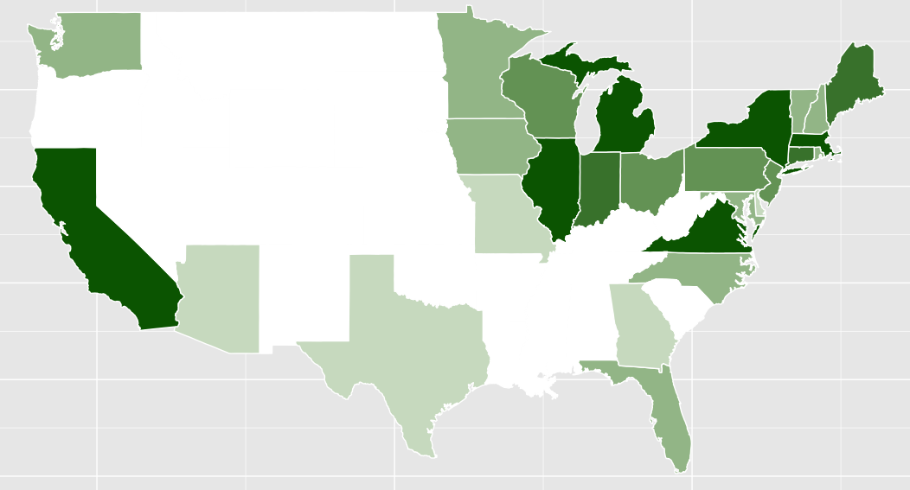
U.S. Shared Print Retentions by State
279K
126K
753K
141K
1.5M
3.3M
3.6M
253K
410K
4.3M
1.4M
482K
166K
2.2M
1.9M
924K
707K
113K
37K
2.8M
9K
3.2M
3.8M
236K
17K
17K
47K
100K

Slide 3
Background
Wanted a shared approach to managing legacy print collections for the long-term
Able to build on existing trust & resource sharing networks in Maine
Looking to be leaders in the print collection space

Slide 4
Project Partners

Slide 5
Original Collection Analysis
(IMLS) grant of $821,065 to create a shared print collections
strategy, grant period 2011 to 2015
Worked with the vendor Sustainable Collection Services (SCS) to compare holdings across the group & agree on criteria for:
Which titles to commit to retain for 15-years
How many copies to retain
How retention commitments should be allocated to individual libraries

Slide 6
Results of Analysis

Slide 7
Governance of MSCC
Following MSCS grant formed the Maine Shared Collections Cooperative
Memorandum of Understanding acts member agreement and includes terms & conditions of retention commitments
There are policy and procedures for removing and transferring retention commitments & recording commitments in ILSs
Two standing committees Executive Committee & Operations Committee
UMaine established (and funded) role of Maine Shared Collections Librarian to oversee work

Slide 8
Governance - Executive Committee
Marjorie Hassen, Bowdoin College
Ben Treat, Bangor Public Library
David Nutty, University of Southern Maine
James Ritter, Maine State Library
Joyce Rumery, University of Maine (chair)
Main role: approving new members &
financial planning for 2019 analysis

Slide 9
Governance - Collections & Operations Committee
Joan Campbell, Bowdoin College
Evelyn Greenlaw, University of Southern Maine
Patrick Layne, Bangor Public Library
Jenna Mayotte, Portland Public Library
Ana Noriega, Colby College
Peggy O’Kane, Maine State Library
Deb Rollins, University of Maine, Orono
Krystie Wilfong, Bates College
Kathy Woodside, Jesup Memorial Library (Minerva)
Main role: agreeing retention rules

Slide 10
Sustaining MSCC
Increase the collective collection MSCC:
41 libraries have participated in collection analysis service
34 of those libraries have joined MSCC – now have 40 members!
In 2019, analyzing titles too new to be considered as part of original work:
28 members participating
Working again with SCS
Smaller pool of titles to consider (700k vs. 3 million)

Slide 11
Issues to be Discussed
Concerns regarding libraries being allocated retention for titles that doesn’t account for subject priorities or local usage:
Bates’ offsite storage facility for low circ. items which plan to weed
Colby’s request to not be allocated science, economics, government and anthropology titles

