Slide 1
Looking Beyond Academic Libraries in Shared Print
Matthew Revitt, Maine Shared Collections Librarian
University
of Maine
PAN, June 21, 2019
www.maineinfonet.org/mscs/

Slide 2
Background
Founded in 2011, one of the original monograph shared print programs
Eight founding libraries, unique mixture of public universities, private colleges, public libraries & the state library
grant of $821,065 to create a shared print
collections strategy, grant period 2011 to 2015
Worked with SCS (pre OCLC & GreenGlass) on collection analysis & collectively agreed to retain approx. 1.4 million titles for 15-years

Slide 3
Founding Members
Public universities:
Private colleges:
Public libraries & the state library:

Slide 4
Commitment Totals from 2013-2014

Slide 5
2019 Collection Analysis
Analyzing titles too new to be considered as part of original work (published or added between 2003-2012)
Smaller pool of titles to consider (700k vs. 3 million)
Founding members being joined by 20 additional members (subset of 40 members), inc. some extremely small public libraries.
Collection sizes ranging from 12k to 1 million print titles

Slide 7
Similarities of Including Publics
Public libraries get the idea of shared efficiencies & responsible withdrawals to ensure material isn’t lost from the collective collection
Willing and enthusiastic (& proud) to be playing their part in shared efforts

Slide 8
Differences with Including Publics
Very different philosophies & reasons for being – publics more driven more by demand & activity
Refresh collections more frequently – less willing to retain low use legacy material
Choose to prioritize funding for public facing programming – easier sell to stakeholders than behind the scenes work

Slide 9
Differences with Including Publics
Differing perspectives regarding usage and circulation levels between publics and academics – factoring into retention rules
Retention burdens at two founding publics made them hesitant about future commitments – add to the list of publishers not considered retention worthy & inc. more public libraries in group
To be effective need critical mass of public libraries participating
Public libraries bring unique materials, not held by academic libraries

Slide 11
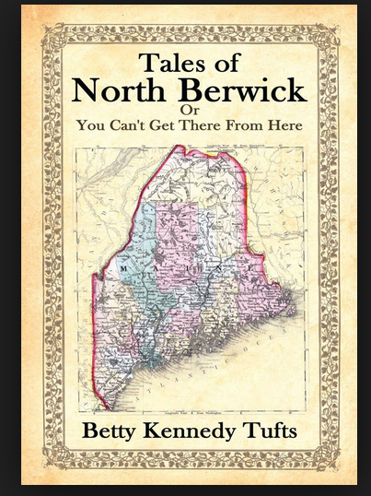

Slide 12
Conclusion
Including more libraries shares the retention burden and lessons load of founding partners
Publics bring different perspectives to the table & facilitated further multiple type collaboration
Good PR of working with Maine library community
PLA proposal hoping to spread word of shared print & replicating MSCC

